Slide 1
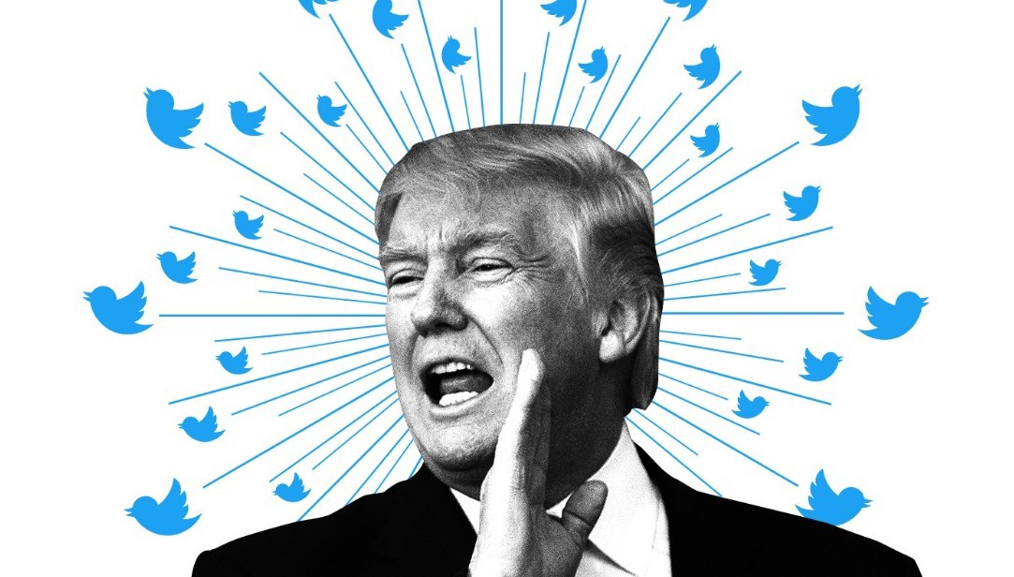
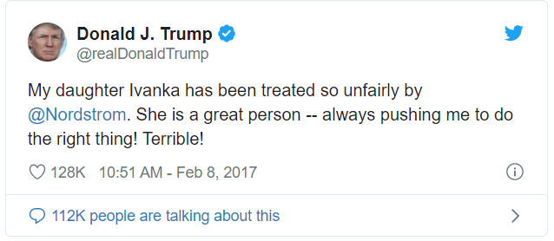
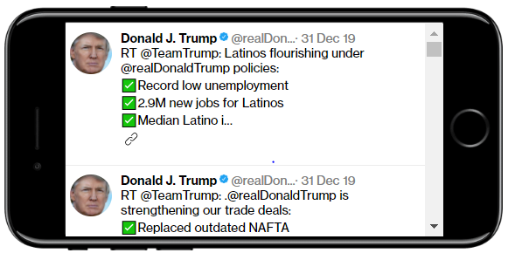
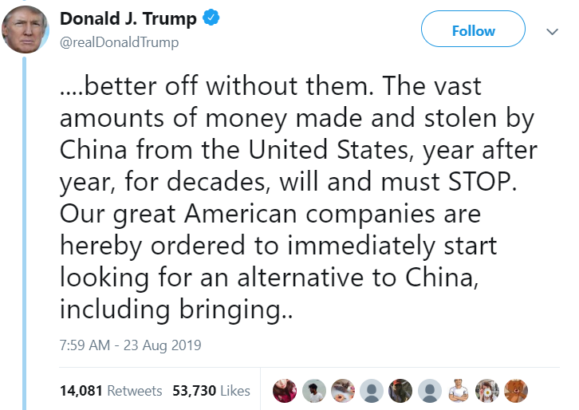
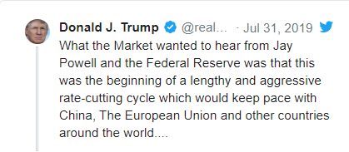
Trump, Tweets, and Trade !!!
Effect of Sentiment Signal from Trump on stock indices
The Team: Tweeter Diviners
Chris Simmons - Lead
Donatien Toni
Sreedevi Agasthya
Nirguna Joshi

Slide 2
Agenda
1. Scope, Motivation and Summary 2. Tweet data collection 3. Stock Market data collection 4. Data cleaning 5. Data Visualization 6. Conclusion 7. Scope for improvement 8. Q &A

Slide 3
Abstract, Motivation & Summary:
Abstract / Scope:
We are primarily analyzing president Trump’s tweets, how it affects the stock market prices and figure out if there is any correlation between these two or not .
Motivation:
We always hear the buzz about the Trump tweets affect the market, it is believed to certain extent that there is a correlation between his tweets and the market prices
Everyday there are large amounts of tweets posted through twitter, around 6,000 tweets are tweeted on Twitter every second which corresponds to 500 million tweets per day
This large volume of data has been arguably providing valuable insights about public sentiments on various topics and has led to a recent growth in research of public’s sentiment and its relationship to financial markets.
Determining the public’s sentiment by retrieving online information on the market can be valuable in creating trading strategies.
Although there are many debates around, if President Trump’s tweet is the background noise for markets or not!!!
There might be plenty of reason why the stock market plunged but we will focus on our goal to see if President Trump’s tweet has any effect on the market or not.

Slide 4
Summary:
To achieve this, we broke down the scope into 4 tasks:
1. Tweet data Collection: used Python
We did the data mining of Trump tweets using http://www.trumptwitterarchive.com/ on daily basis for 4 years starting from 2016 to 2019.
53 weeks, on average Trump tweets 148 times a week with max. 425 tweets in 2019, average DJ index change was 2.6% and S&P500 3% a week.
2. Stock Market Data Collection – for Dow Jones, SPX and Forex – used Python
Second, we retrieve the market prices from Stooq and process them for analysis. We did collect the data for Dow Jones, SPX and Forex.
3. Data clean up, Streamline Tweet Collection – Excel, Pandas.
We transformed collected daily data into, weekly, monthly and yearly to make use of it into our analysis.
4. Data Visualization and Tweet- Stock Correlation - Matplotlib
Finally, we combined all the required data and visualize our findings for conclusion-01
Regression analysis to make the conclusion-02
Conclusion: Correlation of all the above time.
After the detailed analysis we did make the conclusion, we have 2 part in out conclusion:
Part01: with the visualization plots we do see there is correlation between Trump tweet and Stock
Part02: With the regression analysis we did find out that its not just the Trump tweet which affects the market and there are few other factors which affect.

Slide 5
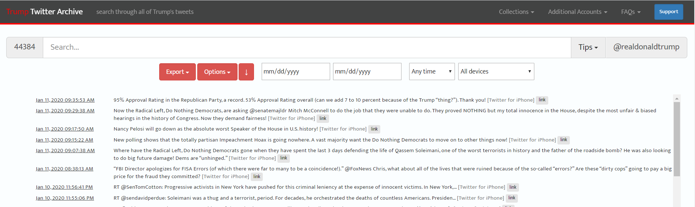
Task Details:
1. Tweet data Collection
Tweets were pulled as a csv file from http://www.trumptwitterarchive.com/.
The csv contain information such as username, location, time stamp, full tweeted text, retweet count and likes.
CSV file generated for the Trump Tweet:

Slide 6
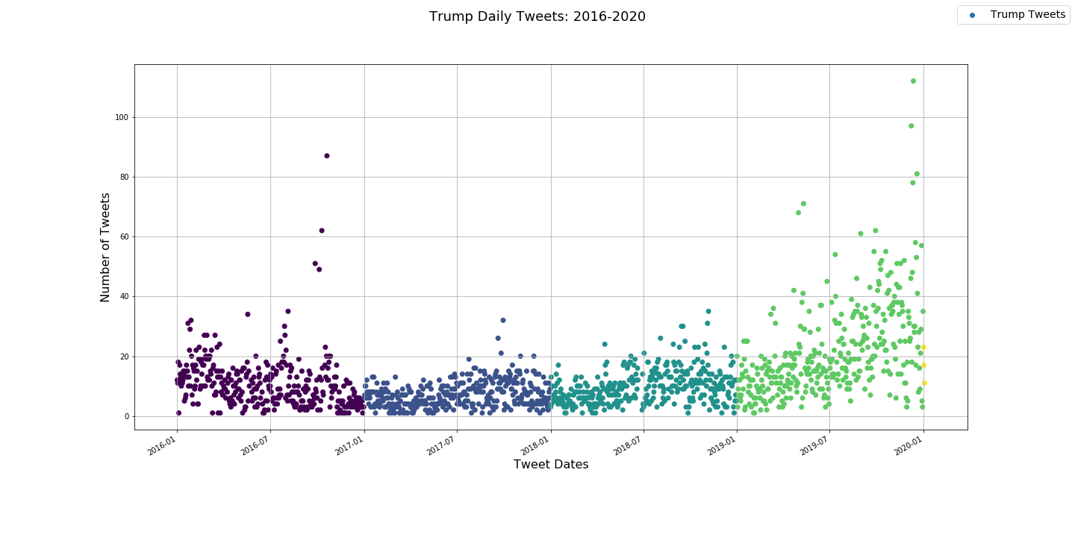
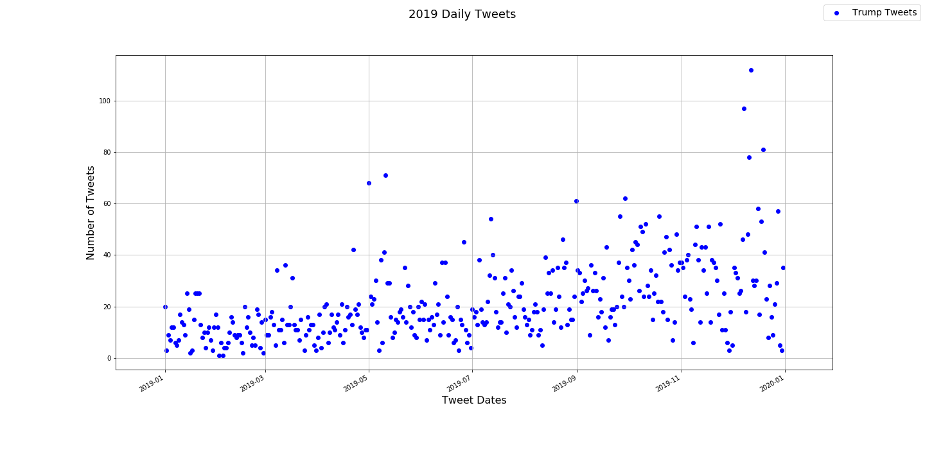
1. Tweet data Collection: Continued….
Created the below visualization plots to get deeper insights of the tweets collected. We used Matplotlib for visualizing the tweet data: plotted down for 2016 to 2019 and for 2019

Slide 7
"
2. Stock Market Data Collection – for Dow Jones, SPX and Forex.
After analyzing the tweet data separately, we collected the stock market data for Dow Jones, SPX and Forex data for the duration starting from 2016 to 2019. To do this, we used the below API to gather data for the duration of trading day.
API used for the stock market data collection: Stooq data we used data from Stooq.com with pandas_datareader.data https://pandas-datareader.readthedocs.io/en/latest/
Tiingo, IEX, Alpha Vantage, Econdb, Enigma, Quandl, FRED, Fama/French, World Bank, OECD, Eurostat, TSP Fund Data, Nasdaq Trader Symbol Definitions, Stooq Index Data, MOEX Data
Stock index’s:
spx_df = web.DataReader('^SPX', 'stooq’)
dji_df = web.DataReader(‘^DJI', 'stooq’)
Foreign Exchange:
https://api.exchangeratesapi.io/history
Output of the Dow Jones, SPX and Forex looks like this: provide couple of images

Slide 8
2. Stock Market Data Collection – for Dow Jones, SPX and Forex – Continued……
Created the below visualization plots to get deeper insights of the tweets collected. We used Matplotlib for visualizing the tweet data: plotted down for 2016 to 2019 and for 2019

Slide 9
3. Data clean up, Streamline Tweet Collection With A Tag (For Sentimental analysis – words which kicked the market)
After we collected the Tweet and Stock market data, we cleaned the data and made in such way that it helps in making the correlation with visualization.
We used both excel and pandas to clean the data. The available daily data is transformed into weekly, monthly and yearly for visualization purpose.
Cleaned csv file, OP from Pandas:
Code Details: attach the code file (Python, Pandas and Matplotlib)

Slide 10
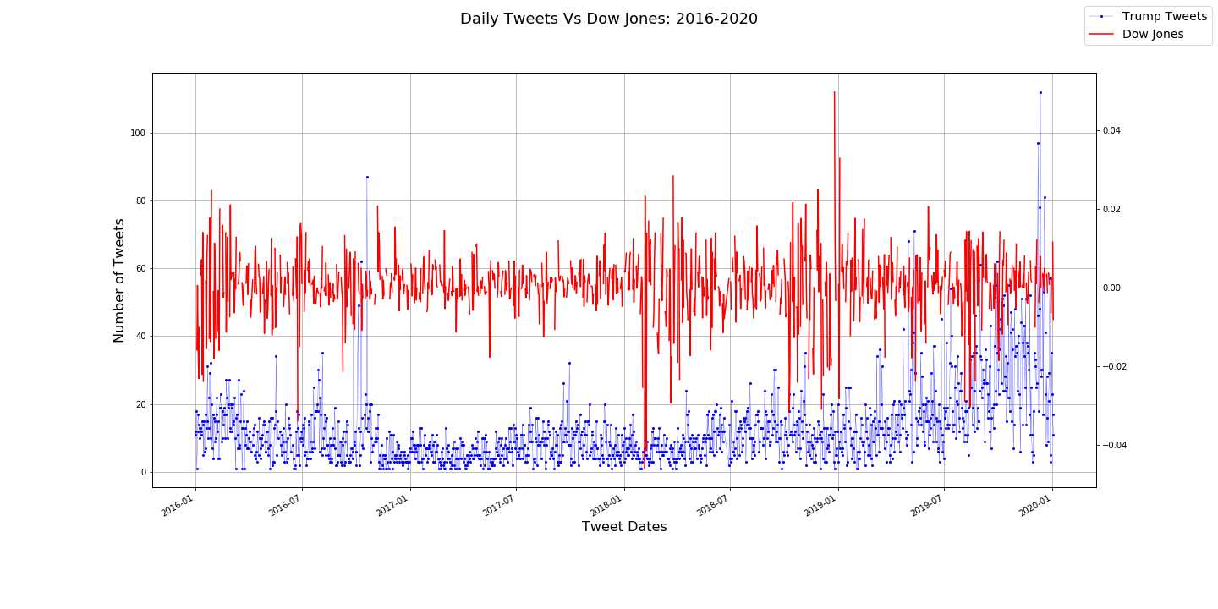
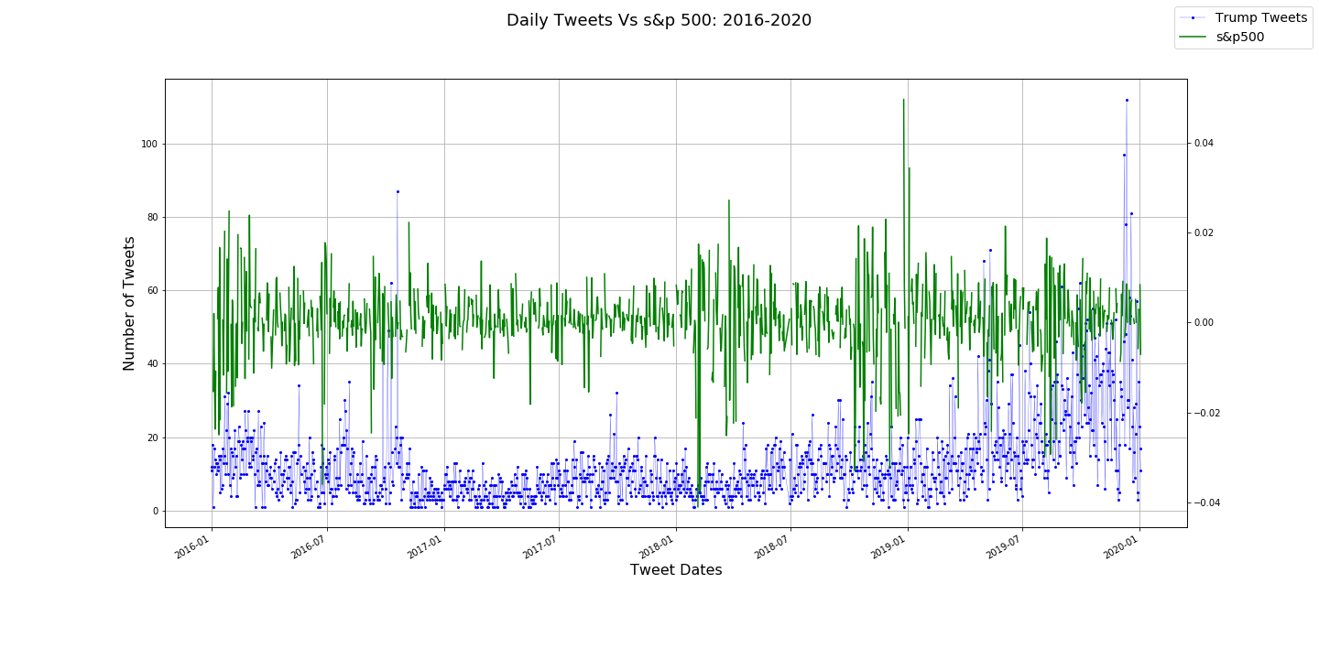
Data Cleaning and plots for Daily Tweets Vs Dow Jones & SPX from 2016 to 2020

Slide 11
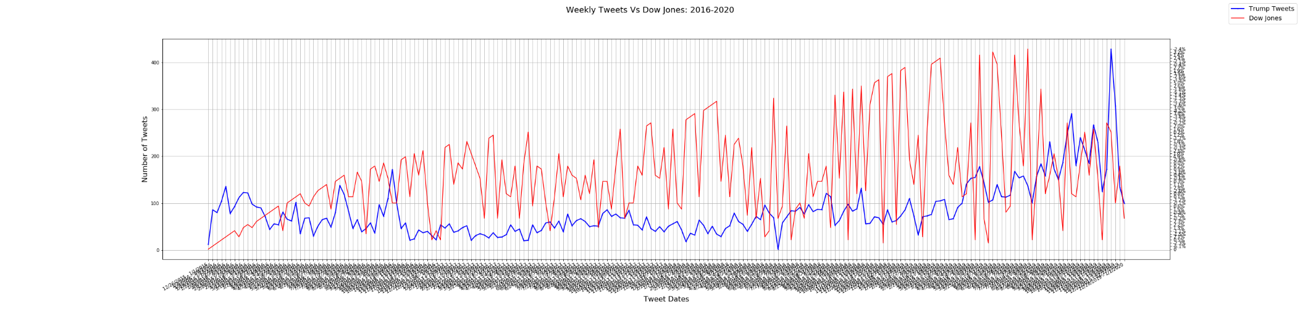
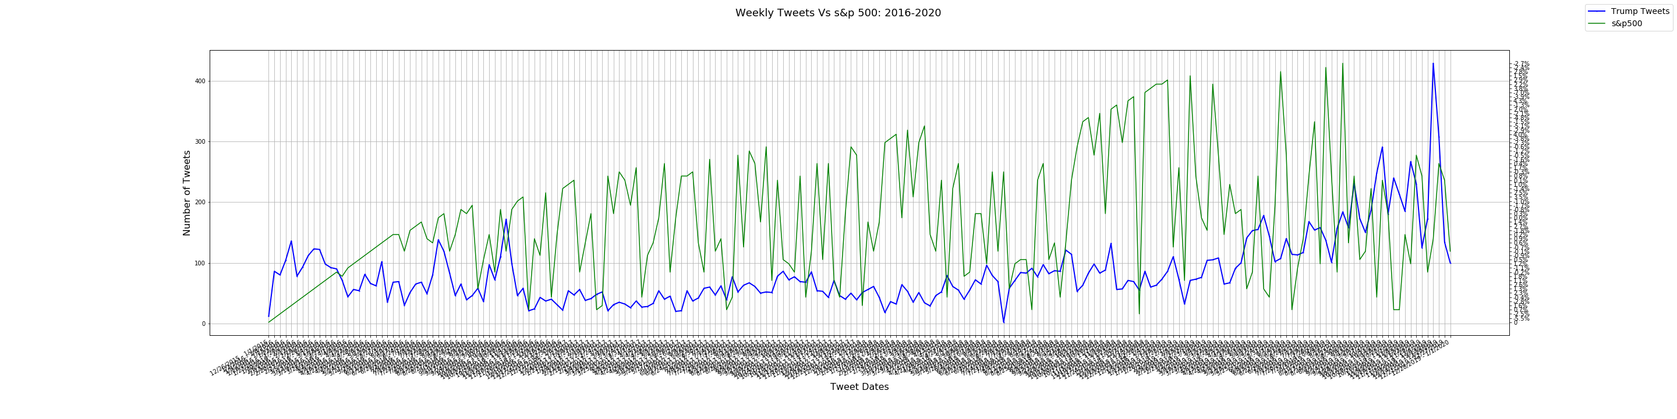
Data Cleaning and plots for weekly Tweets Vs Dow Jones & SPX from 2016 to 2020

Slide 12
4. Data Visualization and Tweet- Stock Correlation
The final step after tagging for correlation would be to combine both the data sets and come up with a visualization that shows us the correlation between the tweets and the stock market variation.
Used Matplotlib for data visualization.
Images for correlation Between Tweets and Stock Prices:
With this, we see there is a correlation between President Trump’s tweet and stock market prices.
For example, Get couple example of 2019 Tweet where the variation is observed and explain the same.

Slide 13
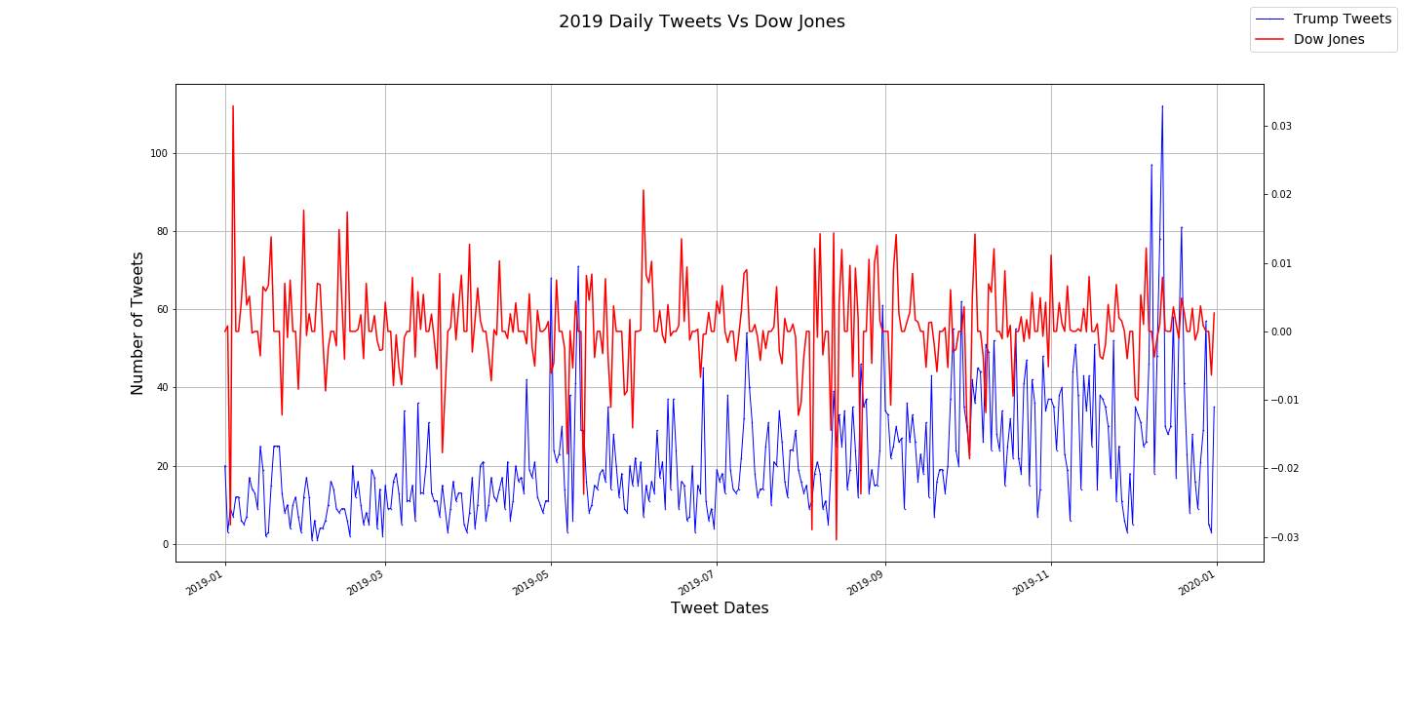
Daily Tweets Vs Dow Jones for 2019
\

Slide 14
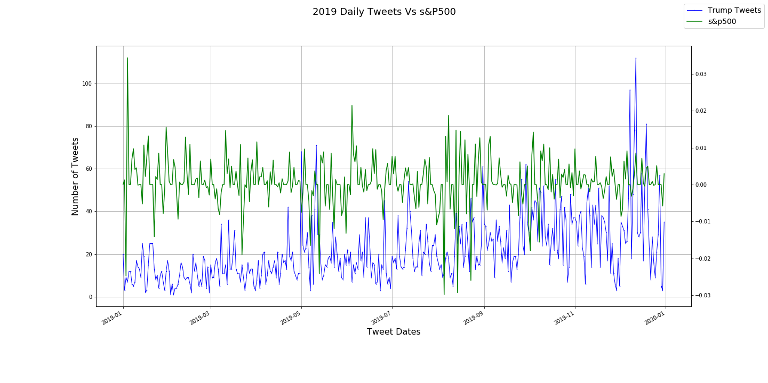

Slide 15
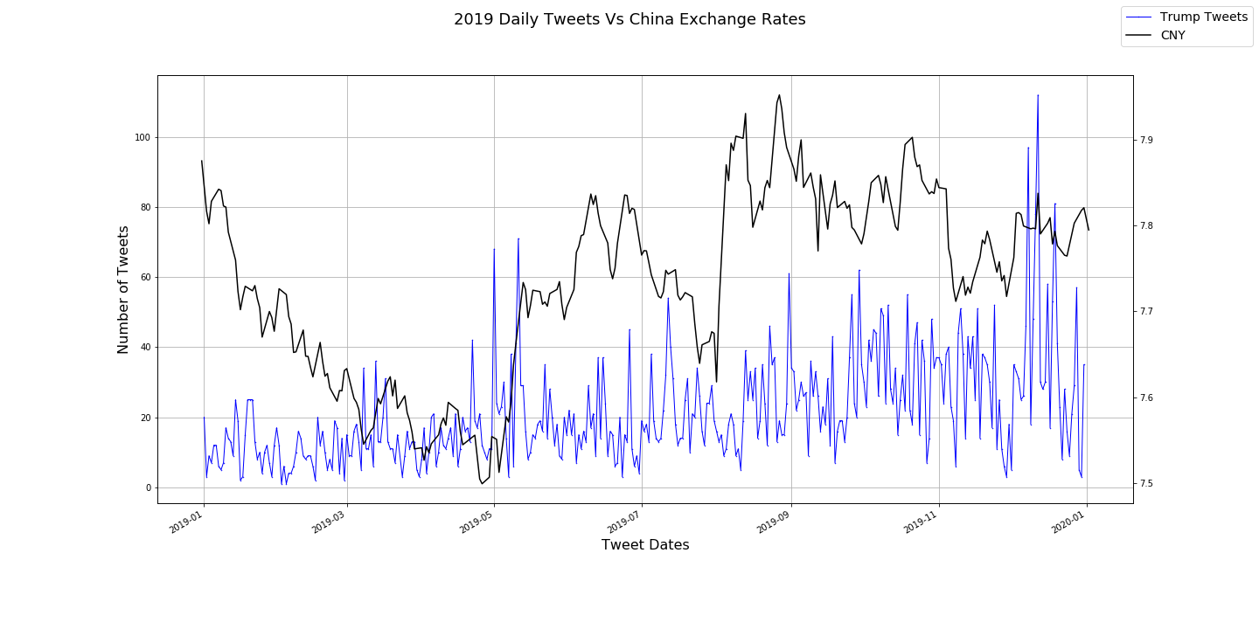
Daily Tweets Vs China Exchange Rates for 2019

Slide 16
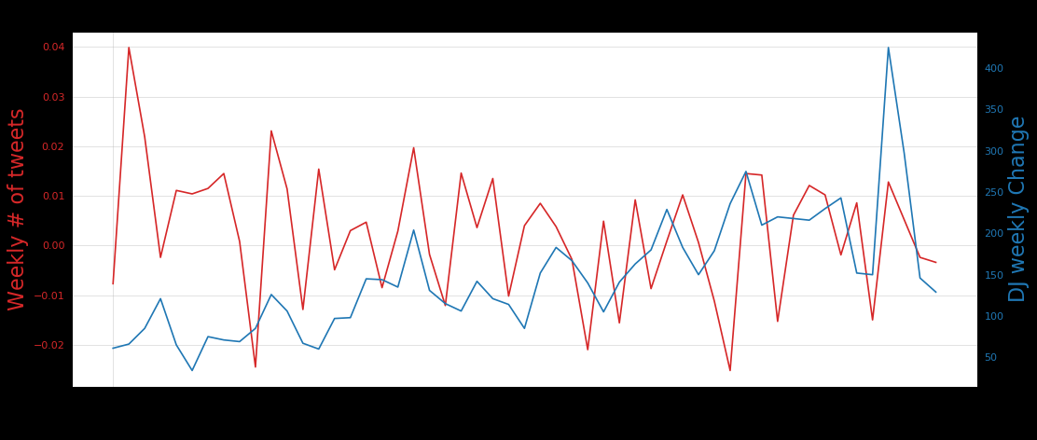
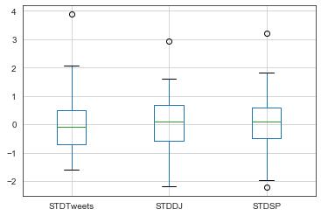
4. Data Visualization and Tweet- Regression Analysis

Slide 17
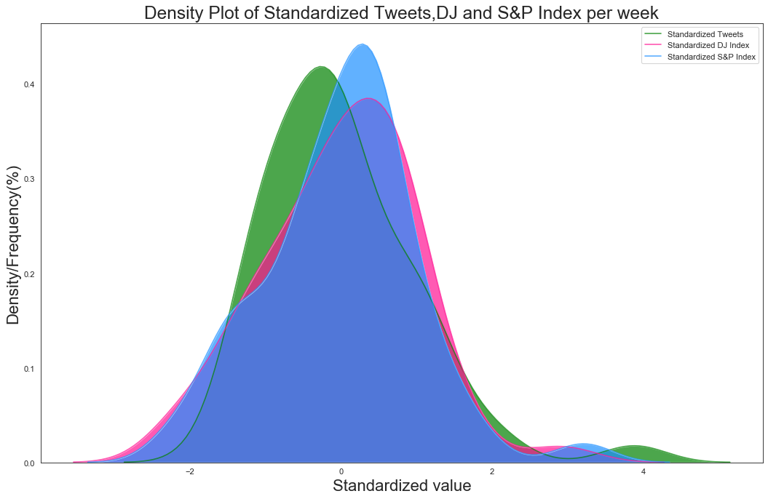
Daily Tweets Vs Dow Jones for 2019

Slide 18
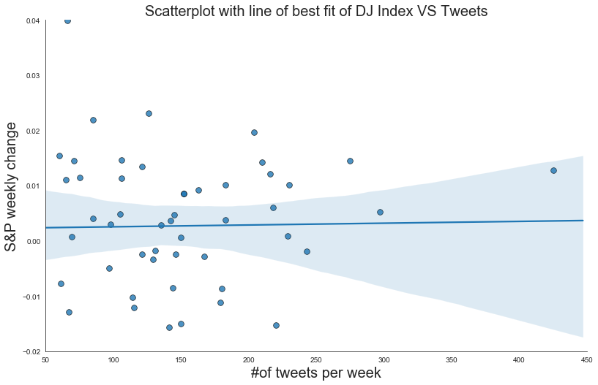
Daily Tweets Vs Dow Jones for 2019
Hypothesis testing
Testing whether Tweets and Dow Jones or S&P500 index have linear relationship using Pearson's Correlation Coefficient.
H0:Tweets and Dow Jones/S&P500 index are independent (P-value > 0.05).
H1:There is a dependency between Tweets and Dow Jones/S&P500 index.
Dow Jones - P-value=0.849
Fail to reject H0: Tweets and Dow Jones index are independent
S&P500 – P-value =0.667
Fail to reject H0: Tweets and Dow Jones index are independent.

Slide 19
Conclusion-01: Stock Correlation
The scope of our analysis was to analyze and visualize the correlation between the tweets and stock market prices by manually marking the correlation tags.
Looking at the correlation between the Tweet and the market movement, we can say that the Trump Tweet definitely affect the market.
In almost every case, when the president unleashes his Twitter (TWTR) fury, the share price of the affected company drops—in some cases fairly significantly. Lockheed Martin’s stock (LMT), for example, plunged by more than 5% in December, after Trump criticized the company by saying the cost of its F-35 jet aircraft contract was “out of control.”
Even Nordstrom (JWN), which Trump attacked just a few weeks ago after the company removed his daughter Ivanka’s fashion designs from their stores, has increased in value since the attack.

Slide 20
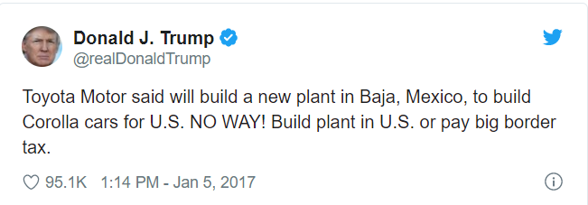
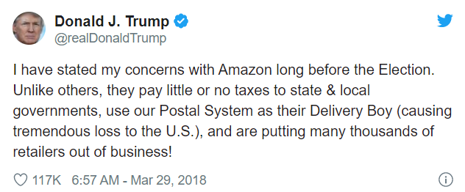
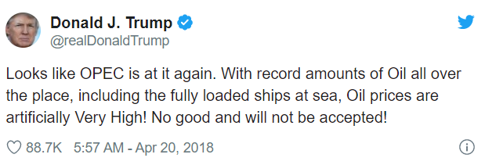
Conclusion-01:Stock Correlation
As a result, the company stocks lost almost US$1.2 million in market cap in just 5 minutes of the tweet being uploaded. Over the next few months, the stock continued its downward spiral, losing a total of $12 billion in market cap.
resulting in high volatility in Amazon’s shares, which fell over 3.8% in the next session. It is interesting to note that a subsequent positive tweet on April 3, 2018, led to an increase in the share price by 1.4%. Amazon suffered losses of £35.5 billion in market cap as a result of this.
Within minutes of his tweet, The Brent crude price fell 0.6%, while WTI fell 0.7%.

Slide 21
Conclusion-02: Regression Analysis
Visually, we can see that the trend of the stock market and Trump’s tweets seem to move together. When running an hypothesis test of dependency between tweets vs stock index, Trump’s tweets do not in fact move with the stock market. In other words, we have no indication of the relationship. There are many individual factors that may affect stock returns such as interest rates, inflation expectations, and other idiosyncratic factors. The interpretation of the relationship we have found is more likely that the tweets coincide with market-moving events such as a surprising economic data release or a monetary policy decision after markets have reacted to the data.

Slide 22
Scope of Improvement / Post Mortem:
It would be an interesting area of future studies to naturally train a neural network model with words and sentiments that seem to correlate to changes in stock prices. In which case we might be able to see stronger correlation of words with stock prices variation.
We can create a machine learning model to use specific emotions for sentiment classification or examine specific words from tweets that are associated with changes in stock prices., a technique that greatly reduces manual tweet tagging.
We also need to include sentimental analysis, Twitter Sentiment Analysis, also known as Opinion Mining, is primarily for analyzing conversations, opinions, and sharing of views (all in the form of tweets) for deciding business strategy, political analysis, and also for assessing public actions

Slide 23
Sources: (Datasets)
https://towardsdatascience.com/trump-tweets-and-trade-96ac157ef082
https://medium.com/@chitu_rk/does-president-trumps-tweet-has-any-correlation-with-stock-market-prices-769ae0fba203
https://www.toptal.com/python/twitter-data-mining-using-python
https://www.digitalvidya.com/blog/twitter-sentiment-analysis-introduction-and-techniques/
https://www.digitalvidya.com/blog/sentiment-analysis/
https://www.barrons.com/articles/donald-trump-twitter-stock-market-51567803655
https://stooq.com/t/
http://www.trumptwitterarchive.com/
https://medium.com/swlh/analyzing-trumps-tweets-5368528d2c90

Slide 24
Q & A, Thank you,

